Slide 1
Getting Started With ‘C’ Language:
Outline
Hello world program
Header file
Constant and variable
Operator

Slide 2
Hello word program
Example :
#include <stdio.h>
int main() {
/* my first program in C */
printf("Hello, World! \n");
return 0;
}
The first line of the program #include <stdio.h> is a preprocessor command, which tells a C compiler to include stdio.h file before going to actual compilation.
The next line int main() is the main function where the program execution begins.
The next line /*...*/ will be ignored by the compiler and it has been put to add additional comments in the program. So such lines are called comments in the program.
The next line printf(...) is another function available in C which causes the message "Hello, World!" to be displayed on the screen.
The next line return 0; terminates the main() function and returns the value

Slide 3

HEADER FILE
It is a command given by programmer to preprocessor to include header file in the source program.
This used when we have a very large program, the code is best divided into several different files, each containing a set of related functions.
There are some functions and some macro definitions that we need almost in all programs.
These commonly use functions can be stored in a file, and that file can be included in every program.

Slide 4
HEADER FILE
Each header file ended with .h extension. .h extension stands for ‘header file’ that contain function declarations which we can be used in our main C program. The prototypes of all the library functions are grouped into different categories and then stored in different header files.
For example:
math.h – prototypes of all mathematics related functions are stored in the header file ‘math.h’.
conio.h – prototypes of console input/output functions are stored in the header file ‘conio.h’.
stdio.h – prototypes of printf(), scanf() functions are stored in the header file ‘stdio.h’.

Slide 5
Character set
Character Set is the set of the character.
This characters are used to form the word, numbers and expression.
The characters in the c are grouped into the following categories.
Letters : Uppercase A…Z, Lowercase a…z
Digits : All decimal digits 0 to 9
Special Character : ,(comma) .(period) ; (semicolon) :(colon), & (ampersand), # (number sign) etc.
White spaces : Blank Space, Horizontal Space, New Line.

Slide 6
C TOKEN
Smallest Individual units are known as C Tokens.
There are six types of the C Tokens.
Keywords
Identifiers
Constants
String
Special Symbols
Operators

Slide 7
keyword
Keywords are the reserved words in C.
The meaning and working of these keywords are already known to the compiler.
Each keyword has a specific feature.
We can not change the meaning of the keyword.
Keywords are used to perform an internal operation.
Identifier can be same as keywords.
Keywords are case-sensitive and always written in small case letter.
In C Keywords are also called as Reserved words.

Slide 8
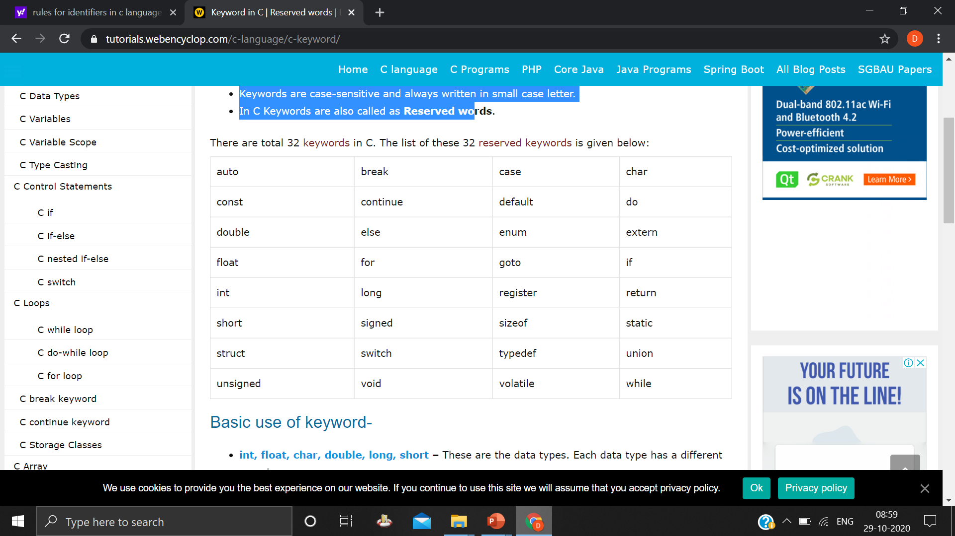
keyword

Slide 9
identifiers
An identifier can only start with letter (A-Z, a-z) or underscore( _ ) symbol.
An identifier can contain alphabet, digits(0-9), and underscore only.
The identifier must not contain white spaces.
A keyword can not use as an identifier.
You can not use punctuation characters (@, #, $, %, &) as identifers.
As C is a case-sensitive language. Thus, MARKS, Marks, marks are different identifiers.
So identifier name should be unique.
Length of an identifier can contain 31 characters.

Slide 10
constant
Const: It is a keyword used to declare a constant variable.
C Constants cannot change their value throughout the program.
Constant variables have to compulsorily initialized at the time of declaration.
Then this value cannot be changed during the entire program execution.
Constants are also called as literals.
Const can be applied to all data types in C language.

Slide 11
INTEGER CONSTANT
An integer constants refers as a sequence of digits.
There are three types of integer constants.
Decimal Integer
Octal Integer
Hexadecimal

Slide 12
DECIMAL CONSTANT
It consists of 0-9 digits, preceded by an optional – or + sign.
Valid example of decimal integer are : 123 , -321, 0 , 654321, +78
Embedded spaces, comma and non digit characters are not permitted between digits.
15 750, 20,000, $1000 are Illegal

Slide 13
REAL CONSTANT
Integer numbers are inadequate to represent quantities such as distance, heights, temperature, price and so on. These quantities are represented by a number containing fractional parts like 12.32. Such numbers are called real constants
These numbers having a whole number followed by a decimal digits.
Example: 0.85, -0.75, 85.45, +241.54

Slide 14
STRING CONTANT
A String Constant is a sequence of characters enclosed in double quotation mark.
Example: “Hello” , “1987”, “Well Done”, “X”
Note : A single String constant does not have an equivalent integer value, while a character constant has an equivalent integer value.

Slide 15
VARIABLE
Variable is a container which will hold value. These value can be used during the execution of the program.
Only one value can be stored in a single variable.
Variable of different data type is used to store different types of data.
Variable is a name given to memory location (storage area).
Variables names are names given to locations in memory.
These locations can contain integer, real or character constants.
For example, Integer variables are used to store integers. Character variables are used to store characters etc

Slide 16
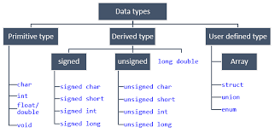
DATA TYPE
Data types in c refer to an extensive system used for declaring variables or functions of different types.
The type of a variable determines how much space it occupies in storage and how the bit pattern stored is interpreted.

Slide 17
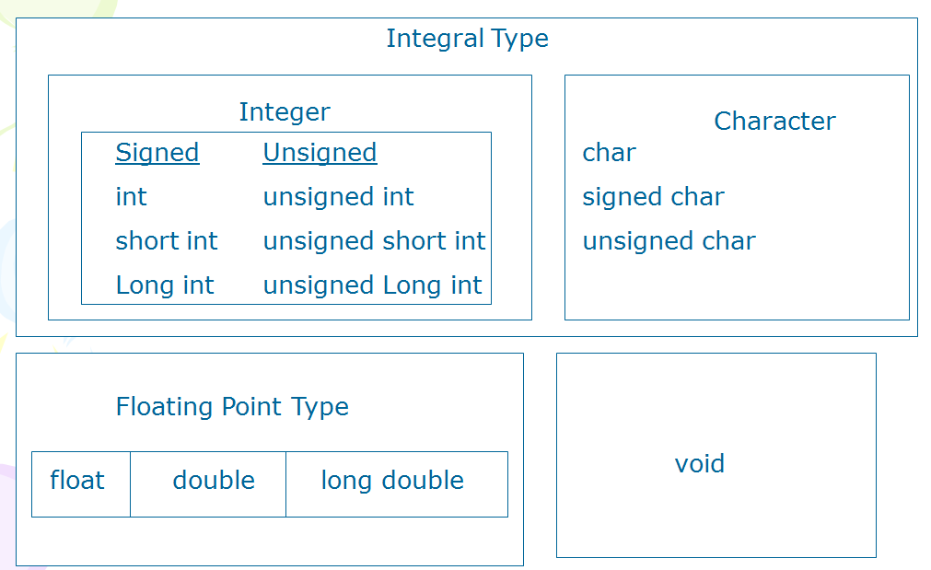
PRIMARY DATA TYPE

Slide 18
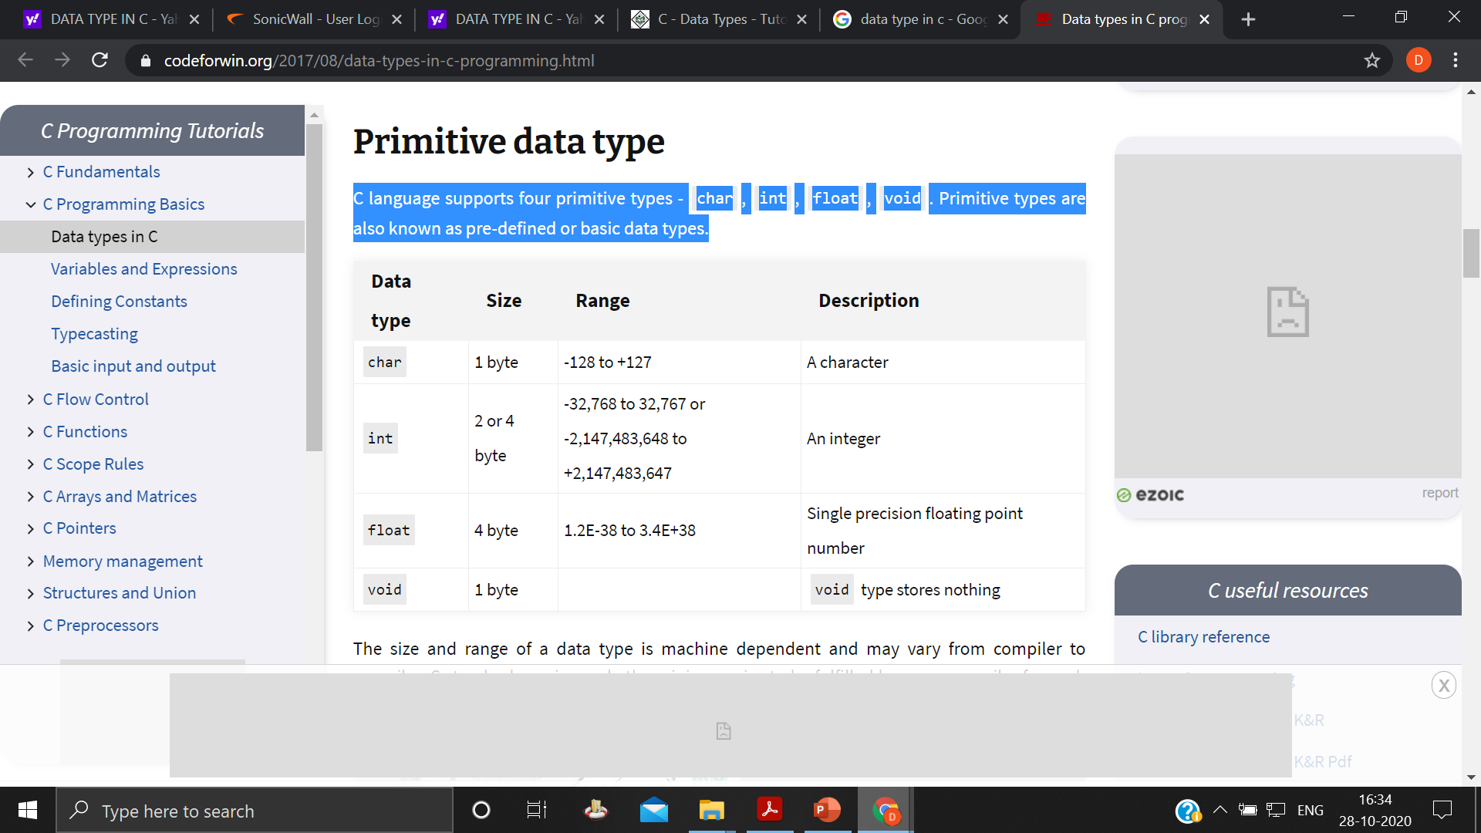
Primitive data type
C language supports four primitive types - char, int, float, void.
Primitive types are also known as pre-defined or basic data types.

Slide 19
Primitive data type
C language supports four primitive types - char, int, float, void.
Primitive types are also known as pre-defined or basic data types.
Integer types:
Integers are whole numbers with a range of values supported by a particular machine.
There are signed integer and unsigned integer. Signed integer uses one bit for sign and other bits for magnitude of the number. Unsigned integers are always positive. It does not contain any bit for sign so that it occupies all the bit for the magnitude of the number.
By using equation -2^n to +(2^n)-1 we can find out the range of the number. Where n is the number of bits.

Slide 20
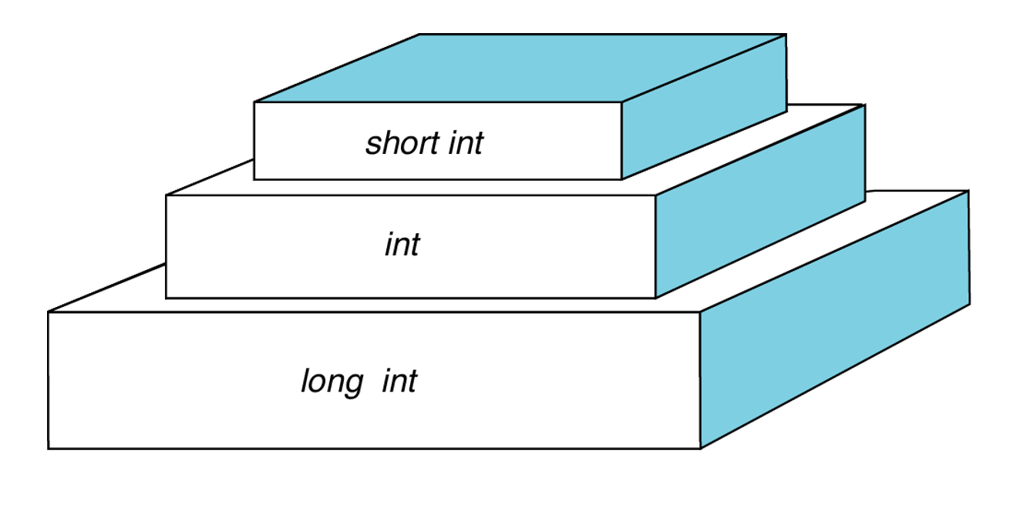

Slide 21
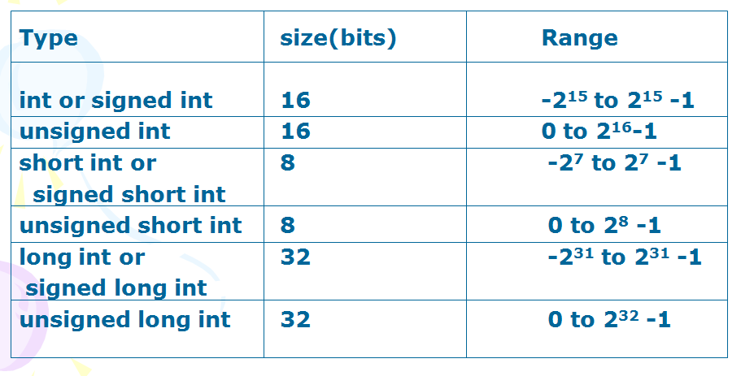
SIZE & RANGE OF INTEGER

Slide 22
FLOATING POINT
Floating point numbers are stored in 32 bits with 6 digits of precision.
Floating point numbers are defined in C by the keyword float.
When the accuracy provided by float is not sufficient double data type is used. It uses 64 bits giving a precision of 14 digits.
When you want to extend more precision you can use the long double data type. It uses 80 bits

Slide 23
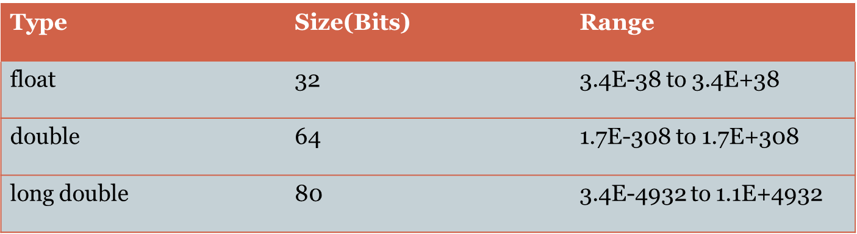
SIZE AND RANGE OF FLOATING POINT DATA

Slide 24
VOID TYPE
Void type has no values.
Void type does not return any values.
These are used to specify the return values from the function when they d o not have any value to return

Slide 25
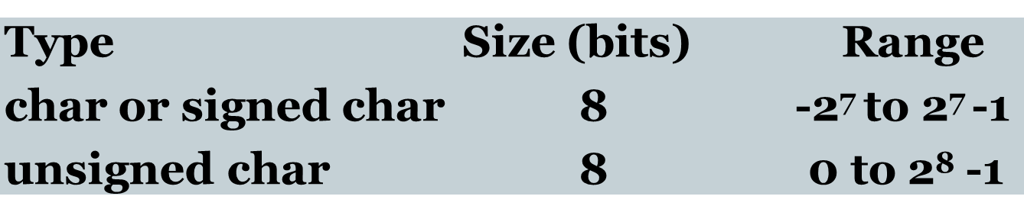
Character type
Character types data in C are defined by keyword char.
Signed chars values from -128 to 127.
Unsigned chars values between 0 and 255.

Slide 26
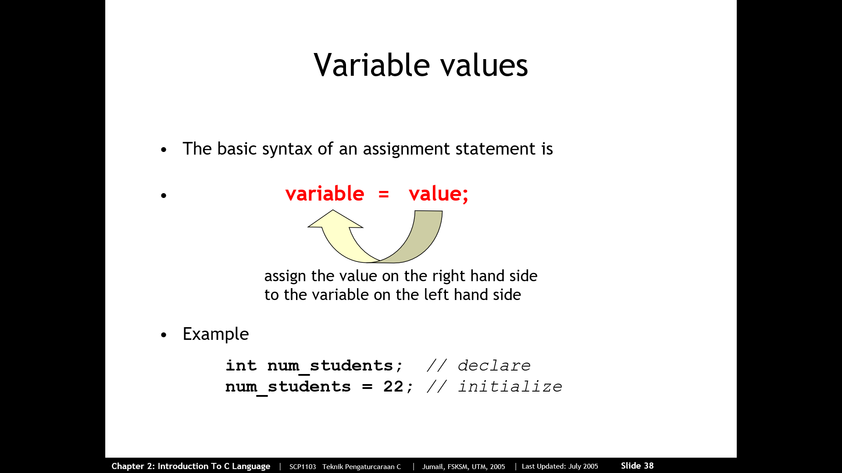
Variable value

Slide 27
Variable vALues

Slide 28
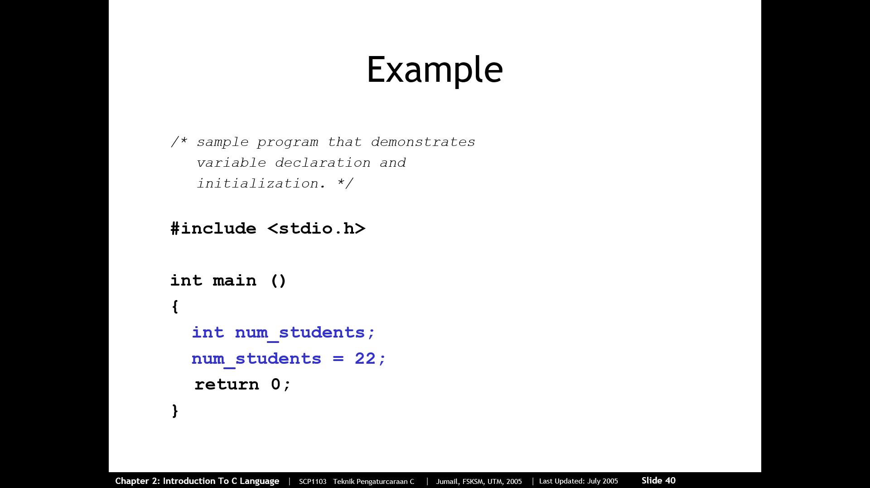

Slide 29
